Slide 1
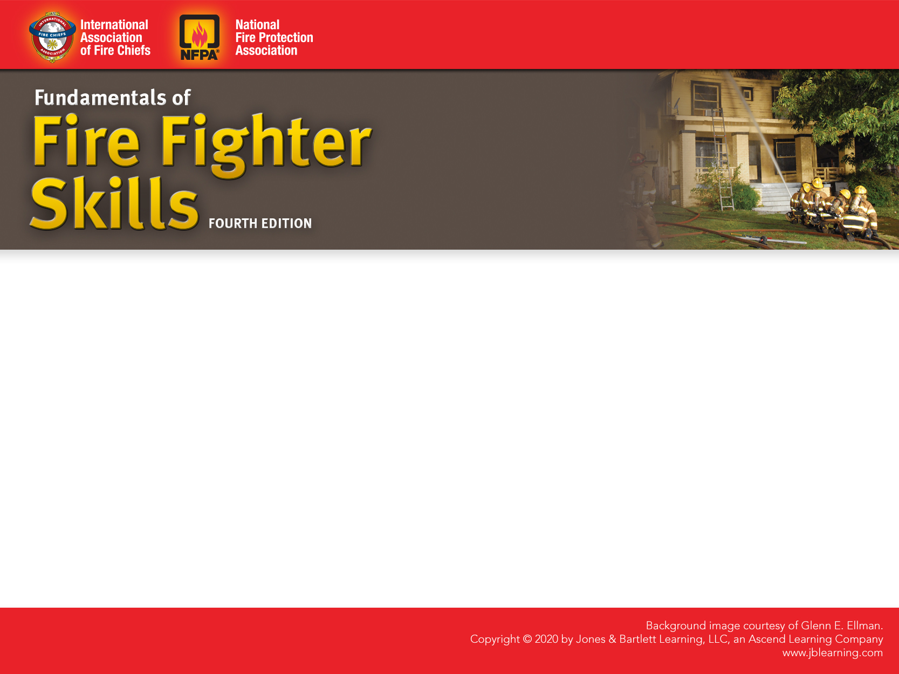
CHAPTER 2
Fire Fighter Health and Safety
Notes:
1

Slide 2
Knowledge Objectives
List the major causes of death and injury in fire fighters.
Describe the 16 fire fighter life safety initiatives.
Describe some of the organizations that set the regulations, standards, and procedures intended to ensure a safe working environment for the fire service
Describe the connection between physical fitness and fire fighter safety.
Notes:
2

Slide 3
Knowledge Objectives
Describe the components of a well-rounded physical fitness program.
Explain the practices fire fighters should take to promote optimal physical and mental health.
Explain the role of a critical incident stress debriefing in preserving the mental well-being of fire fighters.
List signs and symptoms of behavioral and emotional distress.
Notes:
3

Slide 4
Knowledge Objectives
Describe the purpose of an employee assistance program.
Explain how fire fighter candidates, instructors, and veteran fire fighters work together to ensure safety during training.
Describe how to safely mount an apparatus.
Describe how to safely ride a fire apparatus to an emergency scene.
Describe how to safely dismount an apparatus.
Notes:
4

Slide 5
Knowledge Objectives
Describe hazards and safety measures associated with riding apparatus.
List the NFPA standards that require fire fighters to wear safety belts while riding in a fire apparatus.
List the prohibited practices when riding in a fire apparatus to an emergency scene.
Describe how to manage traffic safely at an emergency scene.
Notes:
5

Slide 6
Knowledge Objectives
List the four general principles that govern emergency vehicle operation.
Explain how the teamwork concept is applied during every stage of an emergency incident to ensure the safety of all fire fighters.
Describe how the personnel accountability system is implemented during an emergency incident.
Explain considerations for hazard and scene control.
Notes:
6

Slide 7
Knowledge Objectives
List the common hazards at an emergency incident.
Explain how to shut off a structure’s electrical service.
Describe the measures fire fighters follow to ensure electrical safety at an emergency incident.
Explain how to shut off a structure’s gas service.
Notes:
7

Slide 8
Knowledge Objectives
Explain how to shut off a structure’s water service.
Describe how to lift and move objects safely.
Explain how rehabilitation is used to protect the safety of fire fighters during an emergency incident.
Describe how to ensure safety at the fire station.
Describe how to ensure safety outside of the workplace.
Notes:
8

Slide 9
Skills Objectives
After studying this chapter, you will be able to perform the following skills:
  Mount an apparatus safely.
  Dismount from an apparatus safely.

Slide 10
Introduction
Firefighting is inherently dangerous.
Departments must do what they can to reduce known hazards and dangers.
The final responsibility for personal safety falls to the individual fire fighter.
Notes:
10

Slide 11
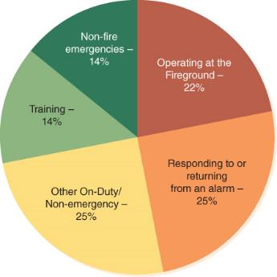
Causes of Fire Fighter
Deaths and Injuries
In 2016, 69 fire fighters were killed in the line of duty.
Deaths occur:
  During operations
  At nonemergencies
  In the station
  During training
  Responding to or
  returning from
  emergencies
Source: National Fire Protection Association, Fire Fighter Fatalities in the United States, 2016.
Notes:
11

Slide 12
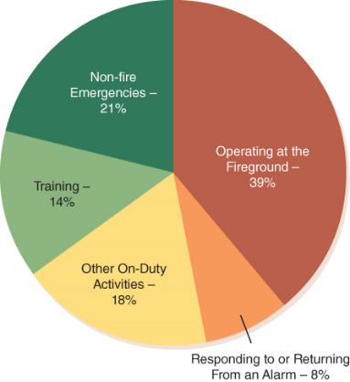
Causes of Fire Fighter
Deaths and Injuries
Cardiac events and vehicle crashes are the leading causes of fire fighter deaths.
According to the NFPA, 62,085 fire fighters were injured in the line of duty in 2016.
Source: National Fire Protection Association, Fire Fighter Injuries in the United States, 2016.
Notes:
12

Slide 13
FireFighter Deaths 2021
Medical Emergencies still the prevalent killer.
Vehicle Crashes still kill just under 15%
Vehicle crashes include FF’s who were killed by lack of spotters.

Slide 14
Reducing Fire Fighter Deaths and Injuries
National Fallen Firefighters Foundation was created in 1992 to remember fallen fire fighters.
  Has expanded in recent years
Most injuries are preventable.
  Near-Miss Reporting System
A successful safety program will address regulations, standards and procedures, personnel, training, and equipment.
Notes:
14

Slide 15
Regulations, Standards, and Procedures
      Standards are issued by nongovernmental entities and are generally consensus based.
Fire service safety is governed by:
  NFPA 1500
  State and federal agencies programs, such as the OSHA
        Regulations are issued and enforced by governmental bodies.
Every department should have SOP/SOGs.
Notes:
15

Slide 16
Personnel
A health and safety program is only as effective as the individuals who implement it.
Teamwork is essential to safe operations.
Freelancing, or acting independently of orders or SOPs, is extremely dangerous and has no place on the fire ground.
A fire fighter who freelances endangers not only himself or herself but everyone else at the scene who may need to rescue that fire fighter.
Notes:
16

Slide 17
Training
Knowledge and skills from training are essential for safety.
  Fire fighters must avoid sloppy practices or shortcuts.
  They also must learn how to identify hazards and unsafe conditions.
Fire fighters must continually seek out additional courses and work to keep their skills current.
Notes:
17

Slide 18
Equipment
Fire fighters must know how to use equipment properly and operate it safely.
Equipment must be properly maintained.
Follow manufacturers’ operating instructions and safety procedures.
Notes:
18

Slide 19
Personal Health and Well-Being
Each department member is responsible for personal health, conditioning, and nutrition.
Fire fighters must exercise regularly, eat a healthy diet, get an adequate amount of sleep, and take preventive measures to avoid illness.

Slide 20
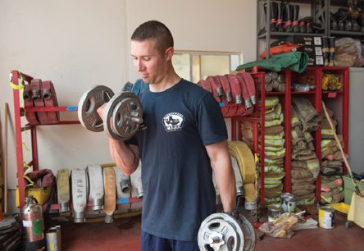
Physical Fitness
All fire fighters should spend at least an hour each day in fitness training.
Must be a career-long activity
© Jones & Bartlett Learning. Photographed by Glen E. Ellman.
Notes:
20

Slide 21
Physical Fitness
You must condition your heart and your muscles to maintain peak performance for as long as possible.
You must condition and strengthen your trunk muscles (Chest, core, back, legs) to be strong, as they will be your base for a long and healthy career.
Cardiovascular endurance is necessary to overall health. Running, HIIT, and circuit training will aid in the development of C/V endurance.

Slide 22
Nutrition
Healthy foods include
  Fruits
  Vegetables
  Healthy fats
  Whole grains
  Lean protein
Pay attention to portion sizes.

Slide 23
Nutrition Continued
You should understand that your nutrition is not only a direct correlation to your overall health, but your fireground performance.
Fad diets have no place in the fire service (keto, paleo, Adkins, etc.) as they deprive you of necessary nutrients that you need to function when your body is in a high-demand state.
Feel good foods are okay, feel good foods all the time are not okay.

Slide 24
Understanding Nutrition
Your body requires a baseline caloric intake to MAINTAIN your body’s baseline.
Consult your physician to determine this caloric balance.
If you consume LESS calories than your baseline, you will lose weight. (Higher deficit, faster loss).
If you consume MORE calories than your baseline, you will gain weight (Higher excess, faster gain).

Slide 25
Calories
When you are exercising strenuously, working hard, moving in any way, you are going to burn calories.
When you are in the fire academy, you will be subjecting your body to short durations of high physical demand for glucose and stored energy to keep your muscles energized and your system able to rapidly recover.
Understand that you will need to have sufficient caloric intake to maintain homeostasis in your body during strenuous physical exercise.

Slide 26
Proteins, Fats, Carbs
Carbohydrates are the primary, rapid uptake, rapid expenditure source of energy for your body.
Fats are long term energy stores that insulate your body and provide energy after carbohydrates have been expended.
Protein carries the same amount of energy as carbohydrates, but have additional compounds of amino acids and nitrogen, necessary to muscle fueling and recovery.

Slide 27
Carbohydrates
Simple Carbs
  Honey, sugar, molasses. (Faster breakdown and uptake, rapidly converts to fat when unused)
Complex Carbs
  Grains, Pasta, Seeds.
Carbs have starches (digestible energy) and fiber (non-digestible)

Slide 28
Fats
Saturated fats are found in red meats, lard, and butter.
Monounsaturated fats are found in most processed oils.
Polyunsaturated fats are found in fish, corn, wheat, seeds, and nuts.
Most dieticians recommend no more than 30% of your caloric intake sourced from fats (excess leads to heart disease, C/V issues, atherosclerosis, etc.)

Slide 29
Protein
Most dieticians recommend an intake of .6-.8 grams of protein intake per pound of body weight when strength training or endurance training (such as firefighting, or fire academy training).
Proteins are sourced from a variety of foods such as meats and beans.
Too much protein places undue stress on the renal system and liver when trying to process it.

Slide 30
Hydration
Consume 8-10 oz of water for every 5-10 min of physical exertion—up to a gallon of water each day.
Proper hydration enables muscles to work longer and reduces the risk of illness and injury.

Slide 31
Hydration
Studies have shown that in the first 18 minutes of strenuous firefighting (First-arriving company evolutions) you lose 25% of your blood plasma.
Blood plasma is responsible for keeping your blood thin, keeping cells separated, and preventing plaque buildup.

Slide 32
Hydration
There is no good way to quantify true hydration loss in firefighting.
The best water to drink after strenuous activity is warm or room temperature water, as it is taken up faster to replace blood plasma volume.
Cold water causes constriction, even though it reduces CBT, reducing uptake into blood plasma.

Slide 33
Hydration
Sports drinks taste good, but we must understand that it can cause stomach duress, resulting in slow or no uptake into the system.
Properly suspended solutions (osmolality of 350 mOsm/L or less) are preferred to help reduce stomach irritation.
Certain drinks or mixes can aid in replacement of sodium and potassium, which is lost in sweat, which is necessary for muscle function.

Slide 34
Sleep
      Establish a consistent sleep schedule and routine.
      If you are tired, say something.
      Get adequate sleep before coming to work, or attending department events.
      Do NOT drink to aid in sleep.
      Do NOT get behind the wheel of a vehicle if you are tired!

Slide 35
Heart Disease
Leading cause of death in the United States and among fire fighters in particular
A healthy lifestyle helps to reduce risk factors.
Regular physical examinations will identify heart disease at an early stage.

Slide 36
Cancer
Synthetic products increase the toxicity of modern fires.
Cancer can be caused by carcinogens such as exhaust from diesel engines, poisonous gases in smoke, and chemical particles.
Turnout gear, especially hoods and gloves, contain high concentrations of carcinogens.
Fire fighters have a 9% higher risk of cancer than the general U.S. population.

Slide 37
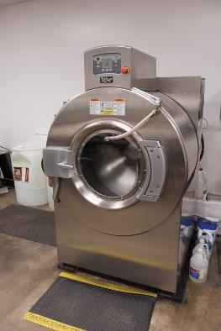
Cancer: Protective Actions
Remove bunker gear and
contaminated clothing ASAP.
Use SCBA from initial attack to
finish of overhaul.
Perform gross field decontamination of PPE to remove as much soot/particulates as possible.
Use cleansing wipes to remove
soot from body immediately and
while on the scene.
Change your clothes and wash them; shower thoroughly.
© Jones & Bartlett Learning. Photographed by Glen E. Ellman.

Slide 38
Cancer: Protective Actions
Clean your PPE, gloves, hood, and helmet immediately after a fire.
Do not take contaminated clothes or PPE home or store them in your vehicle.
Decontaminate the fire apparatus interior after fires.
Keep bunker gear out of living and sleeping quarters.
Stop using tobacco products.
Use sunscreen or sun block.

Slide 39
Tobacco, Alcohol, and Illicit Drugs
Many fire departments prohibit the use of tobacco products by fire fighters, on or off duty.
Alcohol is another substance to avoid.
  Excessive alcohol can damage the body, affect performance, and cause cancer.
Illicit drug use has absolutely no place in the fire service.
  Many departments have drug-testing programs.

Slide 40
Counseling and Critical Incident Stress Management
Fire fighting stressors include:
  Those directly connected to fighting the fire
  Rendering emergency medical care
  Added burdens such as interrupted sleep and meal schedules
Stress can produce a variety of symptoms.
Maintain a healthy lifestyle to combat stressors.
Identify and use resources to maintain behavioral health.

Slide 41
Critical Incident Stress Management
Critical incidents include death, suicide, serious injury, terrorism, etc.
Some individuals have a high capacity to deal with stressful situations; others react negatively.
Critical incident stress can be cumulative.
The recognized stages of emotional reaction include anxiety, denial, anger, illogical function, remorse, grief, and acceptance.
CISM prevents emotional reactions from having a negative impact.

Slide 42
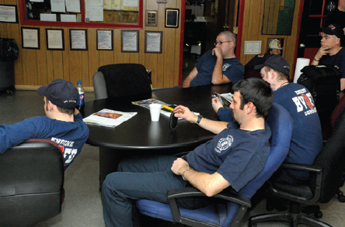
Critical Incident Stress Management
CISM teams usually respond immediately after an incident, and peer support teams provide ongoing support.
Monitor yourself and team members for signs of mental stress.
© Tom Carter/Getty Images.

Slide 43
Suicide Awareness and Prevention
In 2016, there were 99 reported fire fighter suicides.
A fire department is three times more likely to be affected by suicide than a line-of-duty death.
While fire fighters receive training, they may not be prepared for a traumatic situation.
You must recognize signs of stress or depression in others and help them get assistance before the problem gets worse.

Slide 44
Employee Assistance Programs
Provide help with a wide range of problems
  Physical problems
  Financial problems
  Emotional problems
  Substance abuse problems
Fire fighters who use an EAP can do so with complete confidentiality and without fear of retribution.
Notes:
44

Slide 45
Safety During Training
Developing the proper working habits during training courses helps ensure safety later.
Do not attempt anything you feel is beyond your ability or knowledge.
If you see something that you feel is an unsafe practice, say something.
Do not freelance at any time.
Work as a team!
A fire fighter injured during training should not return until medically cleared for duty.
Notes:
45

Slide 46
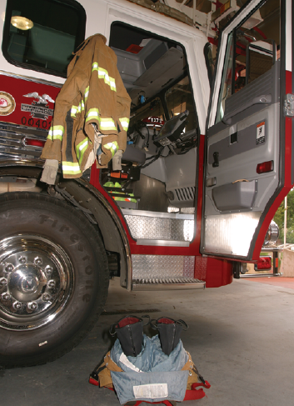
Safety During the
Emergency Response
Safety begins with being prepared.
When you receive the alarm, walk quickly to the apparatus; do not run. You do not want to slip and become injured.
© Jones & Bartlett Learning
Notes:
46

Slide 47
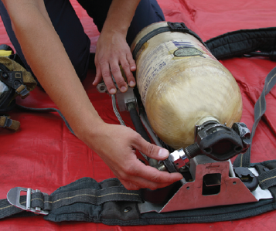
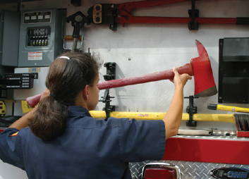
Safety During the
Emergency Response
© Jones & Bartlett Learning. Photographed by Glen E. Ellman.
© Jones & Bartlett Learning. Photographed by Glen E. Ellman.
Notes:
47

Slide 48
Riding the Apparatus
Personal protective gear should be properly positioned so you can don it quickly before getting into the apparatus.
Be sure that seat belts are properly fastened before the apparatus begins to move.
All equipment should be properly mounted, stowed, or secured.
Wear hearing protection.
Always check for traffic before exiting.

Slide 49
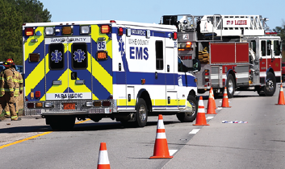
Traffic Safety on the Scene
Follow SOPs.
Placement of emergency vehicles is critical.
If working on highway incident, wear high-visibility safety vests
Comply with all applicable traffic laws.
© Mike Legeros. Used with permission.

Slide 50
Safe Driving Practices
In 2016, there were 15,425 collisions involving fire department emergency vehicles.
Emergency driving requires added considerations.
Driving while impaired is asking for trouble.
Many jurisdictions require a special driver’s license to operate fire apparatus.
Many collisions occur when the operator loses control of the vehicle.
Notes:
50

Slide 51
Laws and Regulations Governing Emergency Vehicle Operation
Emergency vehicle operators are subject to traffic regulations.
Exemptions are legal only when operating in emergency mode.
Operator can be found liable.
An exemption does not relieve the driver from reasonable care.
Follow state laws and regulations.
Notes:
51

Slide 52
SOPs for Personal Vehicles
The use of personal vehicles to respond to fire and emergency medical services (EMS) calls constitutes a fire department function.
Fire departments should have SOPs that dictate the use of personal vehicles.
Notes:
52

Slide 53
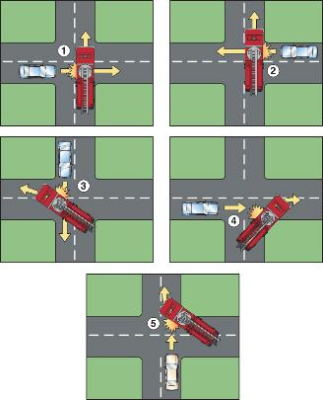
Vehicle Collision Prevention
Take the characteristics of your
vehicle into account.
Anticipate the road and road
conditions.
Make allowances for weather
conditions.
Understand areas of greatest
risk, such as intersections.
Be alert for other emergency
vehicles.
Drive with a cushion of safety.
© Jones & Bartlett Learning.
Notes:
53

Slide 54
The Importance of Vehicle Maintenance
Perform regular maintenance on fire department and personal vehicles, including:
  Engine
  Transmission
  Brakes
  Tires
  Suspension and steering system
  Windshield wipers and washers
  Headlights, taillights, and turn signals
Notes:
54

Slide 55
Safety at Emergency Incidents
Do not charge blindly into action.
Your job is to pay attention and report things that do not match expectations.
Wait for the officer in command to “size-up” the situation before acting.
  Follow the officer’s instructions.
  Always work in assigned teams.
  Do not freelance.
Notes:
55

Slide 56
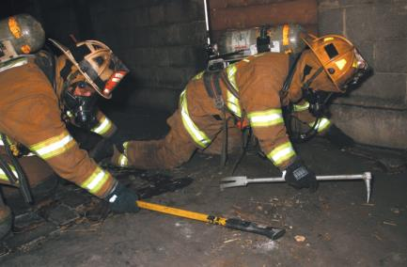
Teamwork
Maintain a minimum of two fire fighters in each team.
Never work alone.
Entire team must leave together.
Maintain contact with each other at all times.
© Jones & Bartlett Learning.
Notes:
56

Slide 57
Personnel Accountability
Accountability system should record:
  Individuals assigned to each team
  Assignments for each team
  Team’s current activities
Provides an up-to-date accounting of everyone who is working at the incident
Fire fighters must learn their department’s accountability system, how to work within it, and how it works within the ICS.
Notes:
57

Slide 58
Scene Hazards
Be aware of your surroundings.
Always operate within established boundaries and protected work areas.
Changing fire conditions will affect safety.
Do not let down your safety guard.
Notes:
58

Slide 59
Utilities
One of the first tasks at most structure fires
  Once utilities are controlled, this should be communicated to the IC.
  If control cannot be completed, the IC should determine the safest course of action.
All fire fighters should know how to shut off a building’s electrical, gas, and water service.

Slide 60
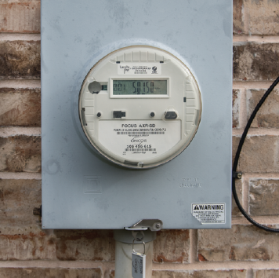
Electrical Service
Invisible emergency scene hazard
Type of electricity delivery depends on utility. company/age of system
Energized power lines may be present.
Always check for overhead power lines when raising ladders.
© Jones & Bartlett Learning. Photographed by Glen E. Ellman.

Slide 61
Electrical Service
During any firefighting operations, the electric power supply should be turned off.
Park apparatus outside the area and away from power lines.
A downed power line should be considered energized until the power company confirms that it is dead.
Do not use water to suppress fires near downed power lines.

Slide 62
Electrical Service
In general, to turn off an electrical service to a structure, you must first identify the circuit breaker box that supplies the building or part of the building in which you need to disconnect the power.
Then you can turn off the main circuit breaker that supplies the whole breaker box.
Work with the utility company if required.

Slide 63
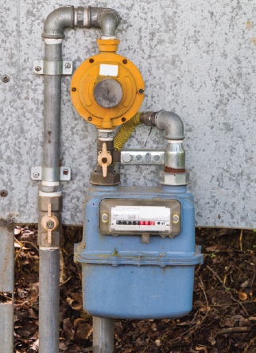
Gas Service: Natural Gas
Delivered through a network of underground pipes
Usually controlled by a single valve outside building or in basement
© lucag_g/Shutterstock, Inc.

Slide 64
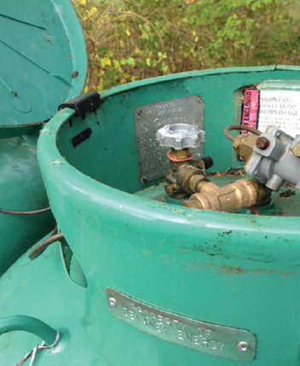
Gas Service: LPG
Delivered by a tank truck and stored on the premises
Shut-off is located at the storage tank.
Rotate the handle into the fully closed position.
Courtesy of Amanda Mitchell.

Slide 65
Water Service
Can usually be shut off by closing one valve at the entry point
Underground valve often accessed through a curb box
Another valve is usually found inside the building where the water line enters.

Slide 66
Lifting and Moving
Do not try to move something that is too heavy alone—ask for help.
Prevent back injuries by always bending at the knees and using the legs to lift.
Use handcarts, hand trucks, and wheelbarrows to move objects over long distances.
Do not move an injured person unless his or her life is in danger.
Notes:
66

Slide 67
Adverse Weather Conditions
Dress appropriately for adverse weather conditions.
Watch your footing on slippery surfaces.
      Check your department’s SOPs for acceptable PPE use in adverse weather.
Notes:
67

Slide 68
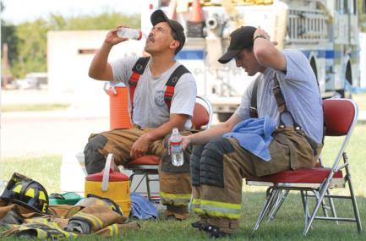
Rehabilitation
Provides periods of rest and recovery for emergency workers
Personnel should not be released until they are rested, refreshed, and ready for another work cycle.
© Jones & Bartlett Learning. Photographed by Glen E. Ellman.
Notes:
68

Slide 69
Violence
Do not proceed to the scene until the police have declared it safe.
Use situational awareness at all times.
If the scene is not secure and there is any threat to personal safety, slowly back away from the emergency scene to a safe distance and ask the police to secure the scene.
If you are confronted with a potentially violent situation, do not respond violently.
Notes:
69

Slide 70
Safety at the Fire Station
Be careful when working with power tools, ladders, electrical appliances, pressurized cylinders, and hot surfaces.
Proper maintenance includes sharpening, lubricating, and cleaning each tool.
All fire fighters should be able to do basic repairs.
Injuries that occur at the firehouse can be just as devastating as those that occur at an emergency incident scene.
Notes:
70

Slide 71
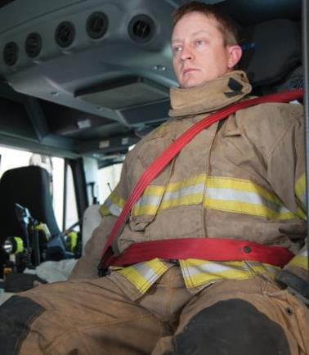
Safety Outside Your Workplace
Follow safe practices when you are off duty.
An unintentional injury can end your career as a fire fighter.
Keep your seat belt fastened.
© Jones & Bartlett Learning. Photographed by Glen E. Ellman.
Notes:
71

Slide 72
Summary
Every fire fighter and fire department must have a strong commitment to safety and health. Safety must be fully integrated into every activity, procedure, and job description.
The majority (42 percent) of all fire fighter deaths are caused by stress, overexertion, and medical issues. Cardiac events account for 38 percent of these deaths.
Notes:
72

Slide 73
Summary
Motor vehicle accidents are the second leading cause of fire fighter fatalities. Always wear your seat belt.
The majority of all fire-ground injuries are caused by overexertion, or strain.
Fire fighters must always consider three groups when ensuring safety at the scene:
  Their personal safety
  The safety of other team members
  The safety of everyone else
Notes:
73

Slide 74
Summary
A successful safety program must have four major components: standards and procedures, personnel, training, and equipment
The National Fallen Firefighters Foundation’s “16 Firefighter Life Safety Initiatives” describes the steps that need to be taken to change the current culture of the fire service to help make it a safer place for all fire fighters.
Notes:
74

Slide 75
Summary
Safety and well-being are directly related to personal health and fitness. You should eat a healthy diet, exercise regularly, stay hydrated, and sleep for 7 to 8 hours.
A well-rounded fitness routine includes weight training, cardiovascular workouts, and stretching.
A well-rounded diet includes appropriate portions of fruits, vegetables, healthy fats, whole grains, and lean protein.
Notes:
75

Slide 76
Summary
Employee assistance programs are available to provide fire fighters with confidential assistance in dealing with a physical, financial, emotional, or substance abuse problem.
The aim of counseling, peer support teams, employee assistance programs, and critical incident stress management programs is to prevent emotional reactions from having a negative impact on the fire fighter’s work and life, over both the short term and the long term.
Notes:
76

Slide 77
Summary
Many fire fighter fatalities occur during training exercises. Do not attempt anything you feel is beyond your ability or knowledge. If you see something you feel is unsafe, say something.
Response actions include receiving the alarm, donning protective clothing and equipment, mounting the apparatus, and transporting equipment and personnel to the emergency incident quickly and safely.

Slide 78
Summary
The response process begins when the alarm is received at the fire station.
Don your PPE before mounting the apparatus or after arriving at the emergency scene. While riding in the apparatus, your seat belt should be secure, and you should be concentrating on mentally preparing for the emergency. Consider any relevant factors that could affect the emergency, such as the weather and the time of day.

Slide 79
Summary
Upon arrival at the scene, traffic safety should be a major concern. Always check for traffic before exiting the apparatus. Follow departmental SOPs to close streets quickly and block access for civilian vehicles.
Four general principles govern emergency vehicle operation:
  Emergency vehicle operators are subject to all traffic regulations unless a specific exemption is made.

Slide 80
Summary
  Exceptions are legal only when operating in emergency mode.
  Even with an exemption, the emergency vehicle operator can be found criminally or civilly liable if involved in a crash.
  An exemption does not relieve the operator of an authorized emergency vehicle from the duty to drive with reasonable care for all persons using the highway.

Slide 81
Summary
Emergency driving requires good reactions and alertness. Driving while impaired or distracted is unacceptable. Your driving record, both on duty and off duty, will impact your career.
Safe driving practices will prevent most vehicle collisions. Anticipate the road and road conditions. Make allowances for weather conditions. Learn where the greatest risks are located on your routes. Be alert for the presence of other emergency vehicles.

Slide 82
Summary
Fire fighters should always work in assigned teams and be guided by a strategic plan. Teamwork and disciplined action are essential to provide for safety and efficient operations.
Upon arriving at the scene, check in to the personnel accountability system. This system tracks personnel and assignments at the emergency scene. Several types of systems are acceptable.

Slide 83
Summary
To protect the safety of fire fighters, controlling utilities is one of the first tasks to be accomplished. The electrical service and gas supply should be shut off and locked.
Do not try to move a heavy object alone—ask for help.
The fire station is just as much a workplace as the fire ground.
Continue to follow safe practices when you are off duty.

